Slide 1


INTRODUCTION TO E-COMMERCE
Lecturer: Nguyen The Dai Nghia
Email: nghiantd@uel.edu.vn

Slide 2

Chapter 4
Main Areas of Working & Career Orientation in E-comerce
Copyright © 2017 Pearson Education Ltd.

Slide 3
Main Areas of Working in E-commerce Enterprise
Planning to approach and develop E-commerce project
Analyze business activities, identify goals and objectives, market segmentation, and target customers
Identify the business model and implementation strategy
Building website
Design, develop and maintain the website of an enterprise
Online marketing and advertising
Display, search, mobile messaging, sponsorships, lead generation, e-mail, affiliate, social network

Slide 4
Main Areas of Working in E-commerce Enterprise
Shipping and delivery in E-commerce
Manage warehousing, transporting goods efficiently, to save costs and create competitive advantages → e-SCM
E-payment
Select payment methods and systems: pay by cash, credit card, bank transfers, mobile wallets and e-wallets
Safety and security in E-commerce
Protect commercial transactions and consumer privacy
Restructuring the company for E-Commerce development

Slide 5
Career Orientation in E-commerce
E-marketing
Marketing of products and services through the global Internet connection. Planning, analyzing and implementing online marketing, social media activities
Activities: Search engine marketing (SEM), SEO - Search engine optimization, web display advertising, email marketing, affiliate marketing, viral, social and mobile marketing

Slide 6
Career Orientation in E-commerce
Search Engine Optimization:
The process of improving your site to increase its visibility when people search for products or services related to your business in search engines (mostly Google)
On-page SEO: optimize HTML source code and build content to improve the ranking.
Off-page SEO: any tactics that not involve making changes to the website or publishing content on site (building back links, social media)

Slide 7
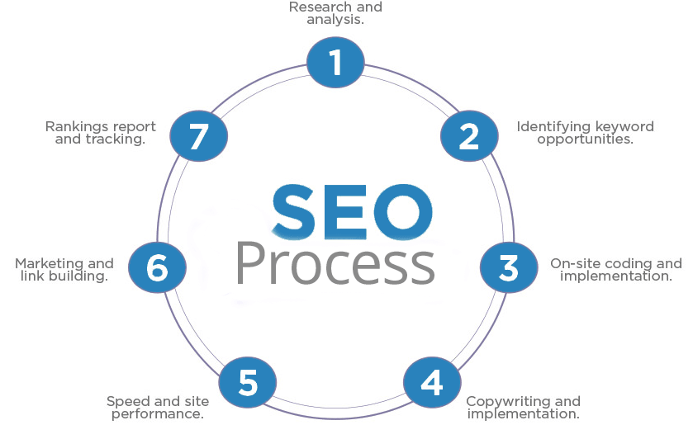
Career Orientation in E-commerce
Search Engine Optimization:

Slide 8
Career Orientation in E-commerce
Web developer:
Build and design websites according to the requirements of customers
Write the code to create a website, design, edit, develop functions, website interface, database
Web master:
Maintain a website, write and optimize content for website; post image, make a report for the operation of the website
Notes:
These jobs support each other to create the success of an e-commerce enterprise.

Slide 9
Career Orientation in E-commerce
Advertising and Promotion managers:
Manage and coordinate advertising and promotions with sales, marketing strategy, market research, pricing strategy, public relations and product development
E-Commerce consultants:
Advise e-commerce enterprise owners to improve their business: improved database system or improved Internet or intranet use

Slide 10
Career Orientation in E-commerce
Mobile application development – App Development:
Operate and develop processes and software to help users access and use applications on mobile devices faster and easier
Developing E-commerce market:
Develop a plan to penetrate E-commerce market
Activities: set up delivery system, choose electronic payment options, build, develop and maintain the company's website

Slide 11
Career Orientation in E-commerce
Customer Relationship Management:
Create a customer care plan.
Plan the implementation of loyalty programs.
Deeply participate in business practice on the principle of listening and understanding, meeting the needs and requirements of customers to the highest level.
Periodically update customer data for brand's marketing programs

Slide 12
Career Orientation in E-commerce
Others:
In charge of e-commerce project management
In charge of electronic payment segment
Responsible for the safety and security of data and information of e-commerce businesses
In charge of online product development
In charge of supply chain management in e-commerce
In charge of business data analysis to support decision making in management

